Slide 1
The Medium Access Control Sublayer Chapter 4
Networks links can be divided into two categories:
Point-to-point connections
WAN is point-to-point links
Broadcast channels/multiaccess channels or random access channels
For fixed channel and traffic from N users
Wireless is a broadcast channel
Analogy
Conference call with six people with different telephones
Medium access control sublayer is a sublayer in data link layer
Multi-access channels and LANs are closely related
So, we discuss about LANs
MAC sublayer is the bottom of the datalink layer

Slide 2

The MAC Sublayer
Responsible for deciding who sends next on a multi-access link
An important part of the link layer, especially for LANs
Application Transport
Network Link Physical
MAC is in here!

Slide 3
Medium Access Control Sublayer
Channel Allocation Problem
Multiple Access Protocols
Ethernet
Wireless LANs
Broadband Wireless
Bluetooth
RFID
Data Link Layer Switching

Slide 4
Channel Allocation Problem
Channel connects one user to other user/users
Portion of wireless spectrum, single wire, optical fiber
Two options:
Static Channel allocation
Dynamic channel allocation
Static allocation
For fixed channel and traffic from N users
Divide up bandwidth using FTM, TDM, CDMA, etc.
This is a static allocation, e.g., FM radio
The static allocation performs poorly for bursty traffic
Allocation to a user will sometimes go unused

Slide 5
Static Allocation: Performance of FDM
FDM
If there are N users, the bandwidth is divided into N equal-sized portions, with each user being assigned one portion.
Issues
When number of senders increase, FDM suffers
If the spectrum is cut up into N regions and fewer than N users are communicating, a large portion is wasted.
Analysis: single channel
Channel capacity=C bps;
Mean time delay= T;
frame arrival rate = ʎ frames/sec,
the frames vary with the average length of= 1/µ bits.
With this the service rate of the channel is µC frames/sec.
As per the standard queuing theory T= 1/(µC- ʎ)
https://en.wikipedia.org/wiki/Queueing_theory
Allocation for dividing the channel into N channels
If we divide the channel into N channels, each can transmit with the capacity of C/N bps; the mean arrival rate is ʎ/N frames/sec. Then,
TN=1/(µ(C/N)- (ʎ/N))= N/(µC- ʎ)=NT
Same arguments will apply for other modes of dividing the channel

Slide 6
Dynamic Channel Allocation
Dynamic allocation gives the channel to a user when they need it. Potentially N times as efficient for N users.
Schemes vary with assumptions:
Assumption | Description | Implication
Independent traffic | The expected number of frames per unit time is constant. After generation the station is blocked till the frame is delivered. | Often not a good model, but permits analysis
Single channel | A single channel is available for all stations. All stations can send and receive | No external way to coordinate senders
Observable collisions | If two frames are transmitted simultaneously, the signal is garbled. All stations can detect. | Needed for reliability; mechanisms vary
Continuous or slotted time | Time may be continuous or slotted. Frame transmissions can begin at the beginning of the slot. | Slotting may improve performance
Carrier sense | Stations can tell if the channel is in use | Can improve performance if available

Slide 7
Multiple Access Protocols
ALOHA »
CSMA (Carrier Sense Multiple Access) »
Collision-free protocols »
Limited-contention protocols »
Wireless LAN protocols »
1/(µC- ʎ)

Slide 8
PURE ALOHA
ALOHAnet, also known as the ALOHA System, or simply ALOHA, was a pioneering computer networking system developed at the University of Hawaii.
ALOHAnet became operational in June, 1971, providing the first public demonstration of a wireless packet data network.
ALOHA originally stood for “Additive Links On-line Hawaii Area”
`

Slide 9
PURE ALOHA
Pure ALOHA
Users transmit frames whenever they have data;
If the frame is destroyed (Collison occurs), users waits a random amount of time and sends it again.
`
In pure ALOHA, frames are transmitted at completely arbitrary times.

Slide 10
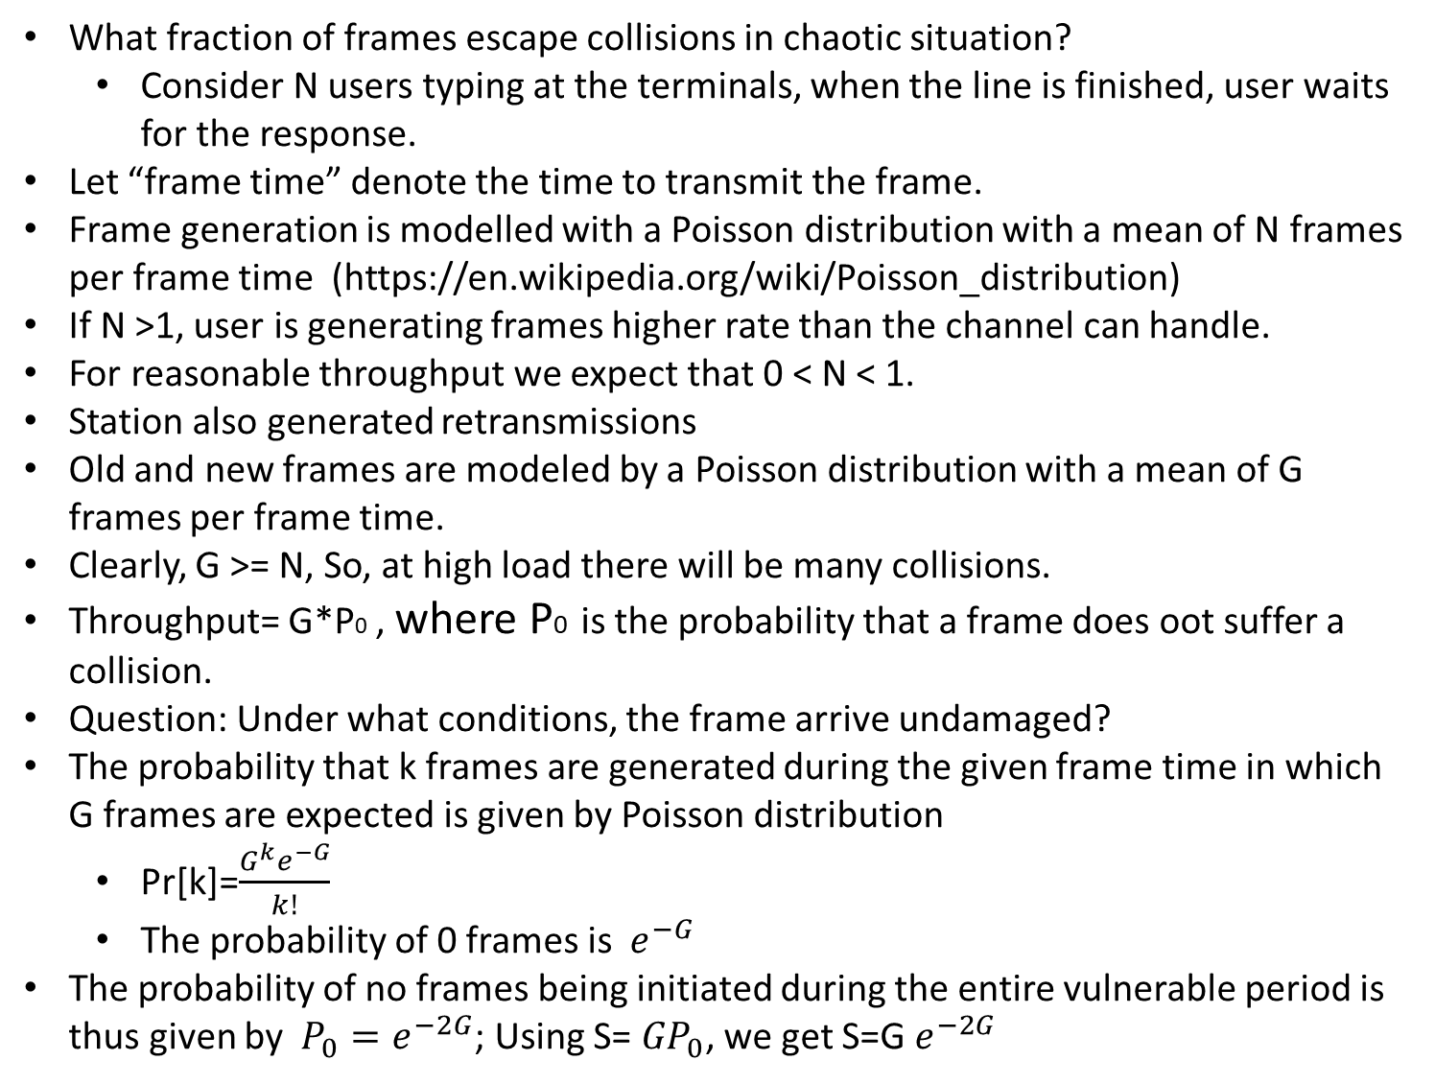
Efficiency of Pure ALOHA
What fraction of frames escape collisions in chaotic situation?
Consider N users typing at the terminals, when the line is finished, user waits for the response.
Let “frame time” denote the time to transmit the frame.
Frame generation is modelled with a Poisson distribution with a mean of N frames per frame time (https://en.wikipedia.org/wiki/Poisson_distribution)
If N >1, user is generating frames higher rate than the channel can handle.
For reasonable throughput we expect that 0 < N < 1.
Station also generated retransmissions
Old and new frames are modeled by a Poisson distribution with a mean of G frames per frame time.
Clearly, G >= N, So, at high load there will be many collisions.
Throughput= G*P0 , where P0 is the probability that a frame does oot suffer a collision.
Question: Under what conditions, the frame arrive undamaged?
The probability that k frames are generated during the given frame time in which G frames are expected is given by Poisson distribution
Pr[k]=$\frac{{G^{k}e}^{−G}}{k!}$
The probability of 0 frames is ${ e}^{−G}$
The probability of no frames being initiated during the entire vulnerable period is thus given by ${ P_{0}=e}^{−2G}$; Using S= ${GP}_{0}$, we get S=G $e^{−2G}$
`

Slide 11
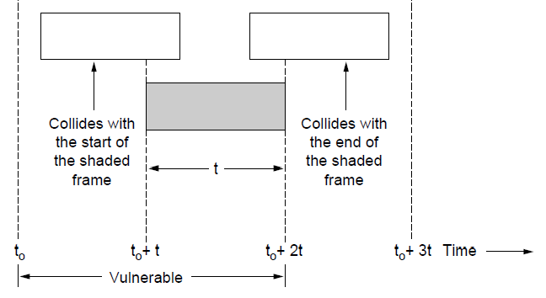
ALOHA (2)
Collisions happen when other users transmit during a vulnerable period that is twice the frame time
Synchronizing senders to slots can reduce collisions

Slide 12
Slotted ALOHA
Divide the time into discrete intervals. Each interval corresponding to one frame.
Allow a special station to emit a pip at the start of the each interval.
Station is not permitted to send at any time. It has to wait for the slot.

Slide 13
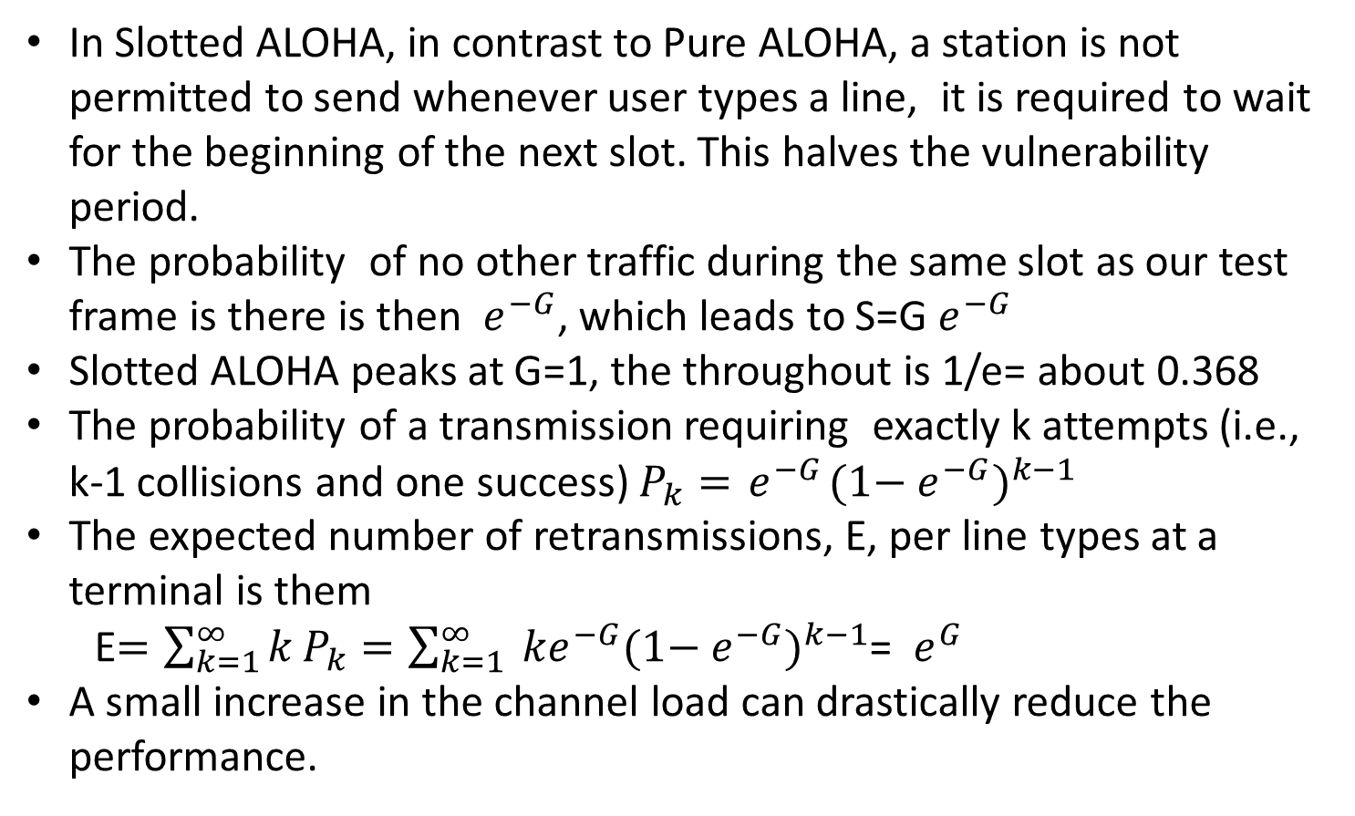
Efficiency of Slotted ALOHA
In Slotted ALOHA, in contrast to Pure ALOHA, a station is not permitted to send whenever user types a line, it is required to wait for the beginning of the next slot. This halves the vulnerability period.
The probability of no other traffic during the same slot as our test frame is there is then ${ e}^{−G}$, which leads to S=G${ e}^{−G}$
Slotted ALOHA peaks at G=1, the throughout is 1/e= about 0.368
The probability of a transmission requiring exactly k attempts (i.e., k-1 collisions and one success) $P_{k}={ e}^{−G}{(1−{ e}^{−G})}^{k−1}$
The expected number of retransmissions, E, per line types at a terminal is them
E$=\sum_{k=1}^{∞}{k}P_{k}=\sum_{k=1}^{∞}{{ ke}^{−G}{(1−{ e}^{−G})}^{k−1}}$= ${ e}^{G}$
A small increase in the channel load can drastically reduce the performance.
`

Slide 14
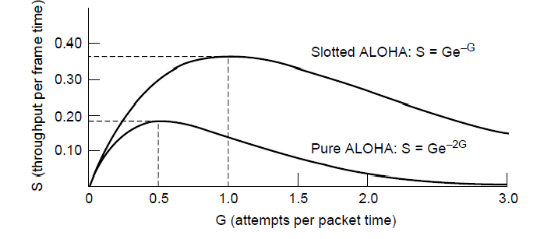
ALOHA
Slotted ALOHA is twice as efficient as pure ALOHA
Low load wastes slots, high loads causes collisions
Efficiency up to 1/e (37%) for random traffic models

Slide 15
Carrier Sense Multiple Access (CSMA)
CSMA (Carrier Sense Multiple Access) improves on ALOHA by sensing the channel!
User doesn’t send if it senses someone else
Variations on what to do if the channel is busy:
1-persistent (greedy) sends as soon as idle
Nonpersistent waits a random time then tries again
p-persistent sends with probability p when idle

Slide 16
1-Persistent CSMA Protocol
When a station has data to send, it listens to the channel
If the channel is idle, the station sends the data
If the channel is busy, the station waits until it becomes idle.
If the collision occurs, the station waits for random amount of time and starts over again.
It is called 1-persistent, because, the station transmits with a probability of 1 when it finds the channel idle.
Issues: when two stations ready, collisions occur, if they are not so impatient.

Slide 17
Nonpersistent CSMA Protocol
Attempt has been made to be less greedy than 1-persistent
When a station has data to send, it listens to the channel
If the channel is idle, the station sends the data
If the channel is busy,
the station does not make effort to seize it immediately after detecting the end of transmission. Instead, it waits for random period of time and repeats the algorithm
Advantages: It has better utilization than 1-persistent CSMA

Slide 18
p-persistent CSMA Protocol
Applies to slotted channels
When a station has data to send, it listens to the channel
If the channel is idle, the station sends the data with probability p. With a probability q=1-p, it defers until the next slot. If that slot is idle it either transmits or defers with probability p and q. this step repeats until either the frame has transmitted or other station has begun transmitting.
If the slot is busy, it considers as a Collison, that it, it waits for random time and starts again.
If the station initially senses that the slot is busy, it waits until the next slot and applies the above algorithm
Advantages: Improved Utilization over nonpersistent CDMA

Slide 19
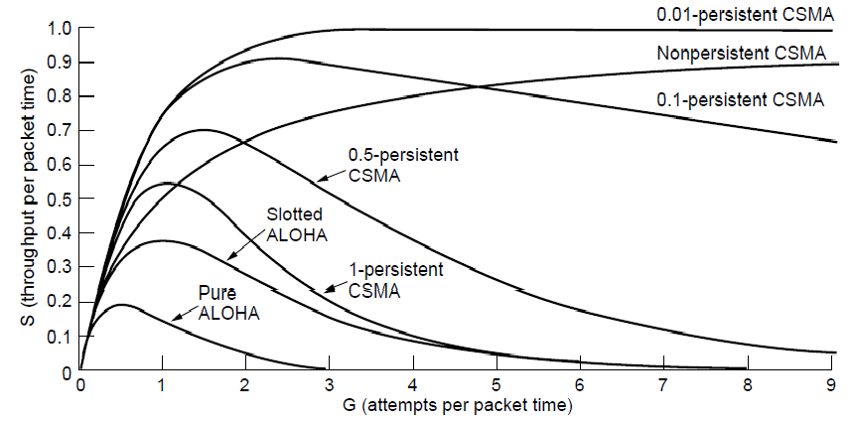
CSMA – Persistence
CSMA outperforms ALOHA, and being less persistent is better under high load

Slide 20
CSMA with Collision detection
In CSMA, if two stations sense a channel to be idle and begin transmitting, the signals will collide.
Alternative: Stations quickly detect collision and abruptly stop transmitting.
It saves time and bandwidth
If a station detects collision, it aborts its transmission, waits a random period of time and tries again.
CSMA/CD consists of alternating contention and transmission periods and idle periods (when all stations are quiet).
If the channel transmits 2*t, whether t is the signal propagation time between the two farthest stations. (for 1KM co-axial cable, t=5 µsec).
Performance is greatly improved if frame time is much larger than the propagation time.

Slide 21
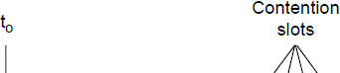
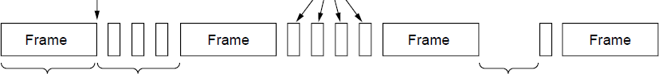
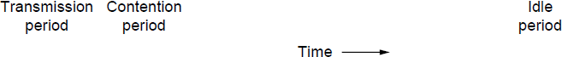
CSMA (3) – Collision Detection
CSMA/CD improvement is to detect/abort collisions
Reduced contention times improve performance
Collision time is much shorter than frame time

Slide 22
Collision-Free Protocols
In CSMA/CD, collisions still occur during the contention period.
It will effect the performance with large t (cable is long)

Slide 23
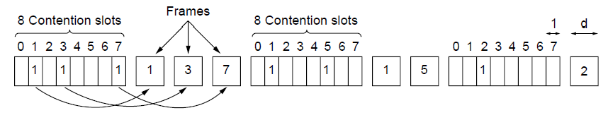




Bitmap Collision-free protocol
Collision-free protocols avoid collisions entirely
Senders must know when it is their turn to send
The basic bit-map protocol:
Contention period consists of N slots.
Sender set a bit in contention slot if they have data
Senders send in turn; everyone knows who has data
Stations transmit data in the numerical order.
Performance:
Low load: bit-map gets repeated. On an average, the station has to wait N/2 slots.
High numbers slots rarely have to wait for next scan.
Lower numbers channels have to wait for 1.5N slots and higher numbered
channels have to wait for 0.5N slots.

Slide 24
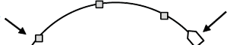
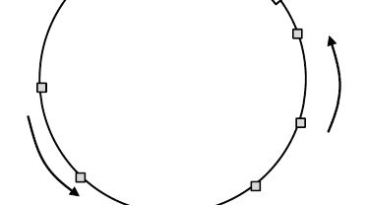
Token Ring-Collision free protocol
Token sent round ring defines the sending order
Station with token may send a frame before passing
Idea can be used without ring too, e.g., token bus
Station
Token
Direction of transmission

Slide 25
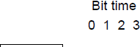
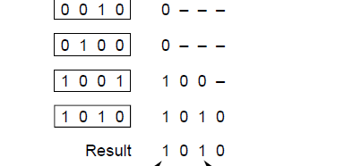
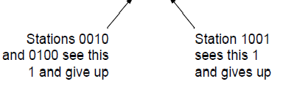
Countdown-Collision Free Protocol
-Bitmap does not scales to thousands of stations
-Binary countdown improves on the bitmap protocol
Stations send their address in contention slot (log N bits instead of N bits)
Medium ORs bits; stations give up when they send a “0” but see a “1”
Station that sees its full address is next to send

Slide 26
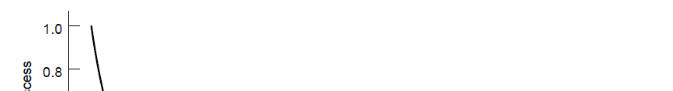
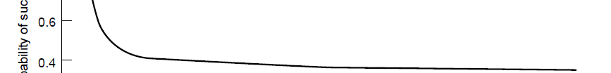
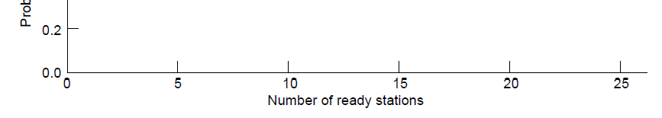
Limited-Contention Protocols
Idea is to divide stations into groups within which only a very small number are likely to want to send
Avoids wastage due to idle periods and collisions
Already too many contenders for a good chance of one winner

Slide 27
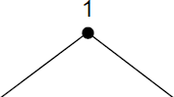
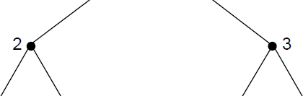
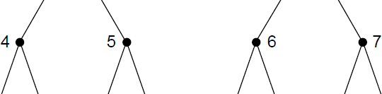
Limited Contention (2) –Adaptive Tree Walk
Tree divides stations into groups (nodes) to poll
Depth first search under nodes with poll collisions
Start search at lower levels if >1 station expected
Level 0
Level 1
Level 2

Slide 28
Wireless LAN Protocols (1)
Wireless has complications compared to wired.
Nodes may have different coverage regions
Leads to hidden and exposed terminals
Nodes can’t detect collisions, i.e., sense while sending
Makes collisions expensive and to be avoided

Slide 29
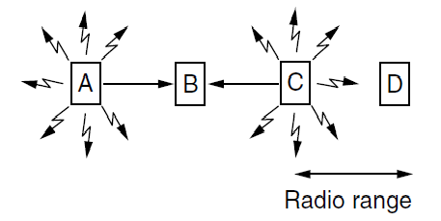
Wireless LANs (2) – Hidden terminals
Hidden terminals are senders that cannot sense each other but nonetheless collide at intended receiver
Want to prevent; loss of efficiency
A and C are hidden terminals when sending to B

Slide 30
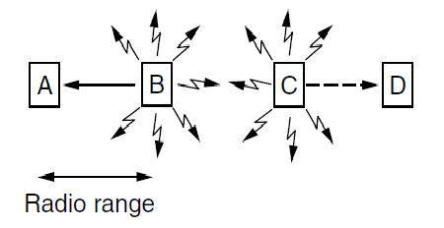
Wireless LANs (3) – Exposed terminals
Exposed terminals are senders who can sense each other but still transmit safely (to different receivers)
Desirably concurrency; improves performance
B → A and C → D are exposed terminals

Slide 31
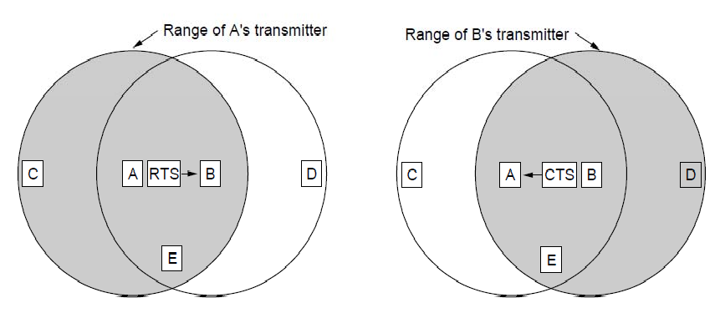
Wireless LANs (4) – MACA
MACA protocol grants access for A to send to B:
A sends RTS to B [left]; B replies with CTS [right]
A can send with exposed but no hidden terminals
A sends RTS to B; C and E hear and defer for CTS
B replies with CTS; D and E hear and defer for data

Slide 32
Ethernet
Classic Ethernet »
Switched/Fast Ethernet »
Gigabit/10 Gigabit Ethernet »

Slide 33
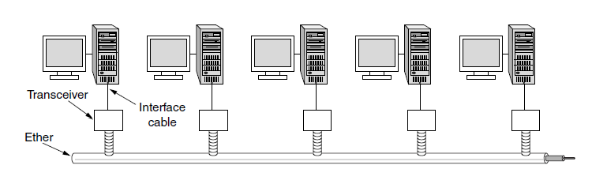
Classic Ethernet (1) – Physical Layer
One shared coaxial cable to which all hosts attached
Up to 10 Mbps, with Manchester encoding
Hosts ran the classic Ethernet protocol for access

Slide 34
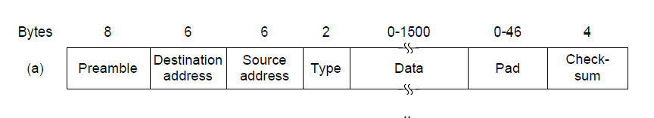
Classic Ethernet (2) – MAC
MAC protocol is 1-persistent CSMA/CD (earlier)
Random delay (backoff) after collision is computed with BEB (Binary Exponential Backoff)
Frame format is still used with modern Ethernet.
Ethernet (DIX)
IEEE 802.3

Slide 35
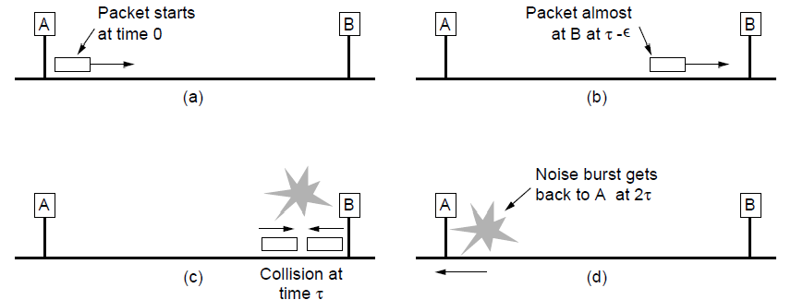
Classic Ethernet (3) – MAC
Collisions can occur and take as long as 2τ to detect
τ is the time it takes to propagate over the Ethernet
Leads to minimum packet size for reliable detection

Slide 36
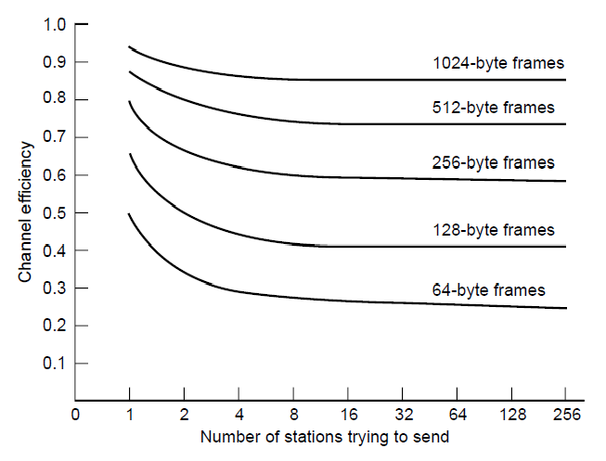
Classic Ethernet (4) – Performance
Efficient for large frames, even with many senders
Degrades for small frames (and long LANs)
10 Mbps Ethernet, 64 byte min. frame

Slide 37
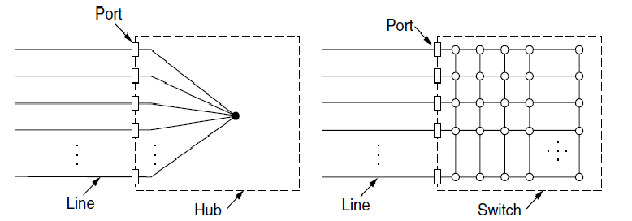
Switched/Fast Ethernet (1)
Hubs wire all lines into a single CSMA/CD domain
Switches isolate each port to a separate domain
Much greater throughput for multiple ports
No need for CSMA/CD with full-duplex lines

Slide 38
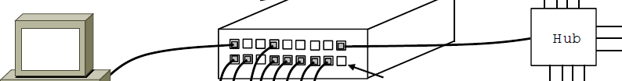
Switched/Fast Ethernet (2)
Switches can be wired to computers, hubs and switches
Hubs concentrate traffic from computers
More on how to switch frames the in 4.8
Switch
Hub
Switch ports Twisted pair

Slide 39
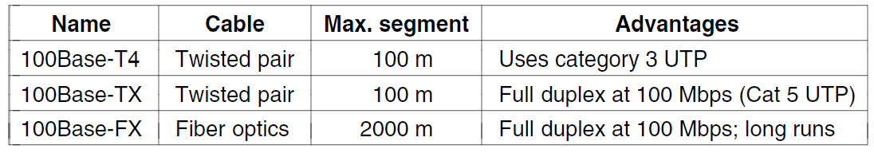
Switched/Fast Ethernet (3)
Fast Ethernet extended Ethernet from 10 to 100 Mbps
Twisted pair (with Cat 5) dominated the market

Slide 40
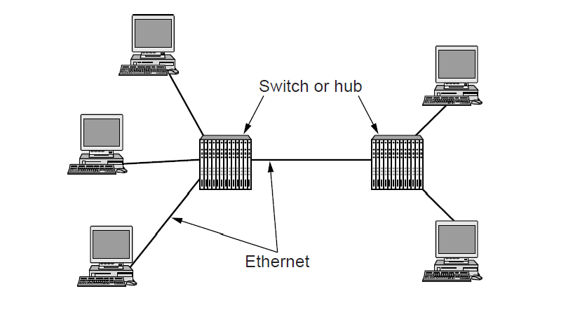
Gigabit / 10 Gigabit Ethernet (1)
Switched Gigabit Ethernet is now the garden variety
With full-duplex lines between computers/switches

Slide 41
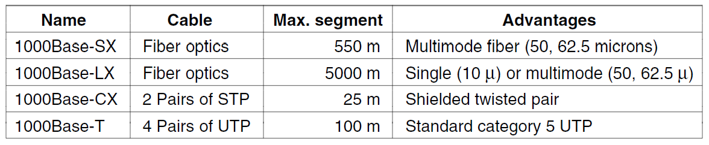
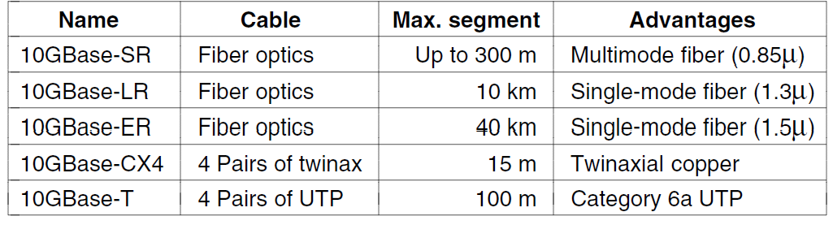
Gigabit / 10 Gigabit Ethernet (1)
Gigabit Ethernet is commonly run over twisted pair
10 Gigabit Ethernet is being deployed where needed
40/100 Gigabit Ethernet is under development

Slide 42
Wireless LANs
802.11 architecture/protocol stack »
802.11 physical layer »
802.11 MAC »
802.11 frames »

Slide 43
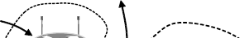
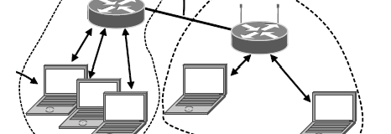
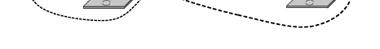
802.11 Architecture/Protocol Stack (1)
Wireless clients associate to a wired AP (Access Point)
Called infrastructure mode; there is also ad-hoc mode with no AP, but that is rare.
To Network
Access
Point
Client

Slide 44
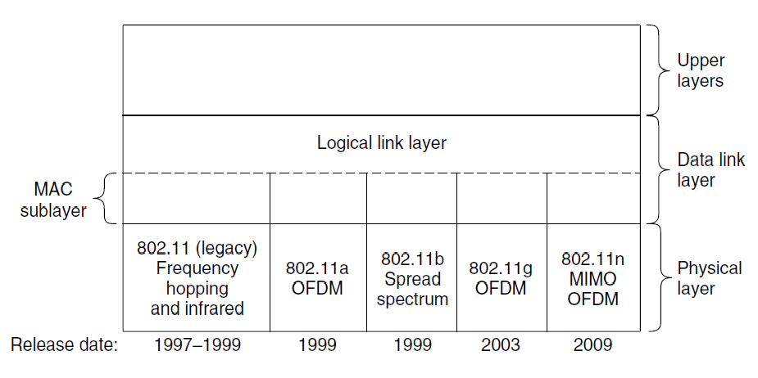
802.11 Architecture/Protocol Stack (2)
MAC is used across different physical layers

Slide 45
802.11 physical layer
NICs are compatible with multiple physical layers
− E.g., 802.11 a/b/g
Name | Technique | Max. Bit Rate
802.11b | Spread spectrum, 2.4 GHz | 11 Mbps
802.11g | OFDM, 2.4 GHz | 54 Mbps
802.11a | OFDM, 5 GHz | 54 Mbps
802.11n | OFDM with MIMO, 2.4/5 GHz | 600 Mbps

Slide 46
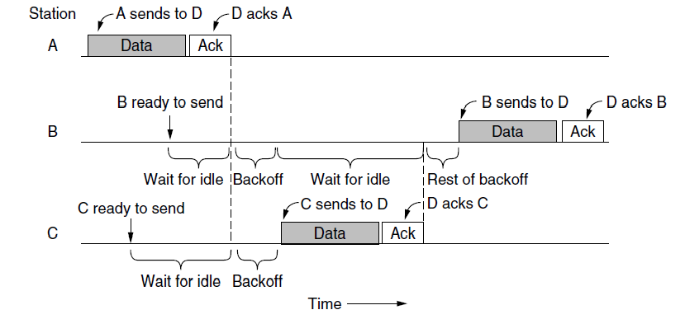
802.11 MAC (1)
CSMA/CA inserts backoff slots to avoid collisions
MAC uses ACKs/retransmissions for wireless errors

Slide 47
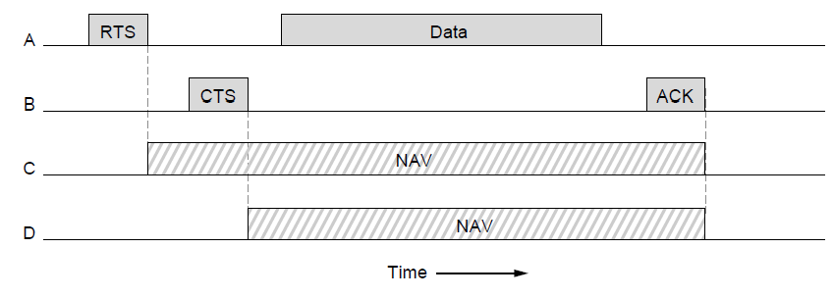
802.11 MAC (2)
Virtual channel sensing with the NAV and optional RTS/CTS (often not used) avoids hidden terminals

Slide 48
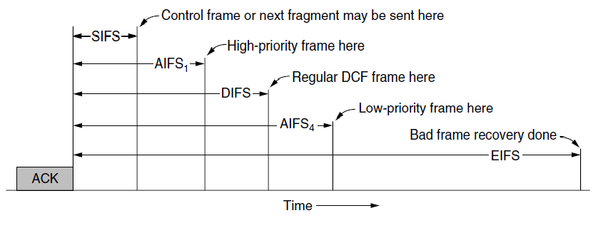
802.11 MAC (3)
Different backoff slot times add quality of service
− Short intervals give preferred access, e.g., control, VoIP
MAC has other mechanisms too, e.g., power save

Slide 49
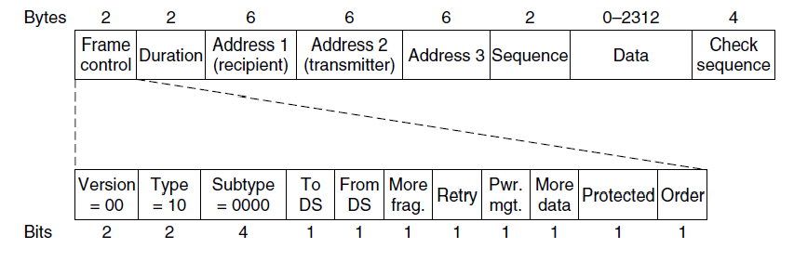
802.11 Frames
Frames vary depending on their type (Frame control)
Data frames have 3 addresses to pass via APs

Slide 50
Broadband Wireless
802.16 Architecture / Protocol Stack »
802.16 Physical Layer »
802.16 MAC »
802.16 Frames »

Slide 51
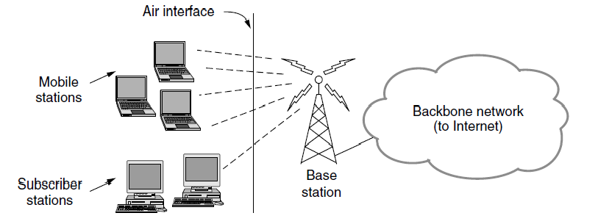
802.16 Architecture/Protocol Stack (1)
Wireless clients connect to a wired basestation (like 3G)

Slide 52
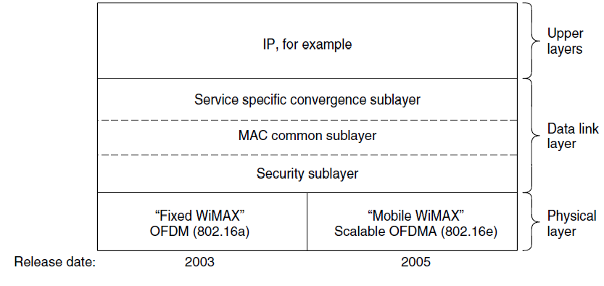
802.16 Architecture/Protocol Stack (2)
MAC is connection-oriented; IP is connectionless
Convergence sublayer maps between the two

Slide 53
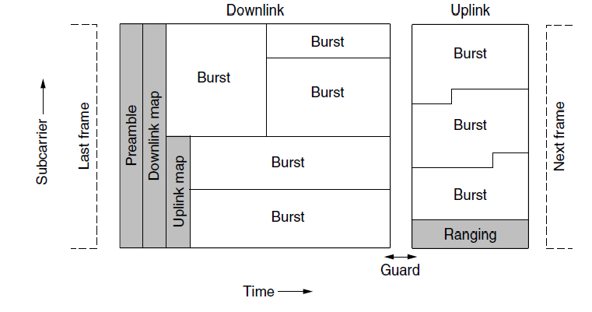
802.16 Physical Layer
Based on OFDM; base station gives mobiles bursts (subcarrier/time frame slots) for uplink and downlink

Slide 54
802.16 MAC
Connection-oriented with base station in control
Clients request the bandwidth they need
Different kinds of service can be requested:
Constant bit rate, e.g., uncompressed voice
Real-time variable bit rate, e.g., video, Web
Non-real-time variable bit rate, e.g., file download
Best-effort for everything else

Slide 55
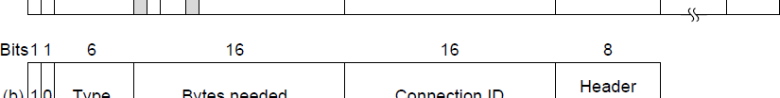
802.16 Frames
Frames vary depending on their type
Connection ID instead of source/dest addresses
(a)
(b)
(a) A generic frame. (b) A bandwidth request frame

Slide 56
Bluetooth
Bluetooth Architecture »
Bluetooth Applications / Protocol »
Bluetooth Radio / Link Layers »
Bluetooth Frames »

Slide 57
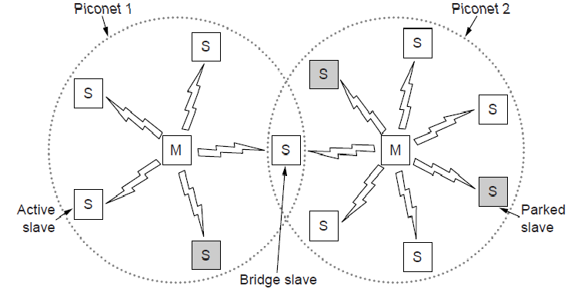
Bluetooth Architecture
Piconet master is connected to slave wireless devices
Slaves may be asleep (parked) to save power
Two piconets can be bridged into a scatternet

Slide 58
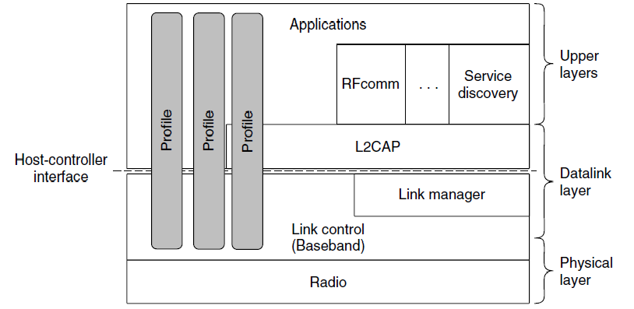
Bluetooth Applications / Protocol Stack
Profiles give the set of protocols for a given application
25 profiles, including headset, intercom, streaming audio, remote control, personal area network, …

Slide 59
Bluetooth Radio / Link Layers
Radio layer
Uses adaptive frequency hopping in 2.4 GHz band
Link layer
TDM with timeslots for master and slaves
Synchronous CO for periodic slots in each direction
Asynchronous CL for packet-switched data
Links undergo pairing (user confirms passkey/PIN) to authorize them before use

Slide 60
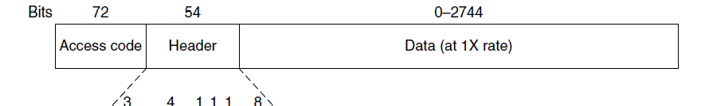
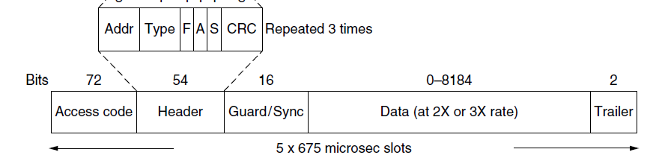
Bluetooth Frames
Time is slotted; enhanced data rates send faster but for the same time; addresses are only 3 bits for 8 devices
(a)
(b)
(a)
(b)

Slide 61
RFID
Gen 2 Architecture »
Gen 2 Physical Layer »
Gen 2 Tag Identification Layer »
Gen 2 Frames »

Slide 62
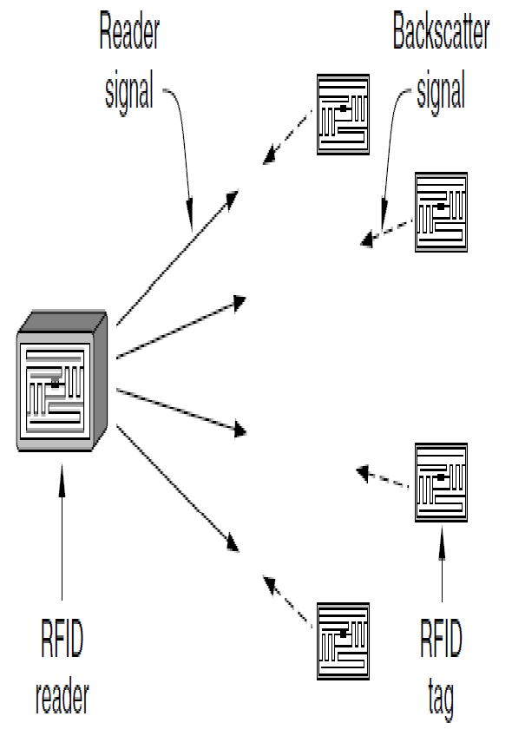
Gen 2 Architecture
Reader signal powers tags; tags reply with backscatter

Slide 63

Gen 2 Physical Layer
Reader uses duration of on period to send 0/1
Tag backscatters reader signal in pulses to send 0/1

Slide 64


Gen 2 Tag Identification Layer
Reader sends query and sets slot structure
Tags reply (RN16) in a random slot; may collide
Reader asks one tag for its identifier (ACK)
Process continues until no tags are left

Slide 65

Gen 2 Frames
Reader frames vary depending on type (Command)
Query shown below, has parameters and error detection
Tag responses are simply data
Reader sets timing and knows the expected format
Query message

Slide 66
Data Link Layer Switching
Uses of Bridges »
Learning Bridges »
Spanning Tree »
Repeaters, hubs, bridges, .., routers, gateways »
Virtual LANs »

Slide 67

Uses of Bridges
Common setup is a building with centralized wiring
Bridges (switches) are placed in or near wiring closets

Slide 68

Learning Bridges (1)
A bridge operates as a switched LAN (not a hub)
Computers, bridges, and hubs connect to its ports

Slide 69
Learning Bridges (2)
Backward learning algorithm picks the output port:
Associates source address on frame with input port
Frame with destination address sent to learned port
Unlearned destinations are sent to all other ports
Needs no configuration
Forget unused addresses to allow changes
Bandwidth efficient for two-way traffic

Slide 70

Learning Bridges (3)
Bridges extend the Link layer:
Use but don’t remove Ethernet header/addresses
Do not inspect Network header

Slide 71

Spanning Tree (1) – Problem
Bridge topologies with loops and only backward learning will cause frames to circulate for ever
Need spanning tree support to solve problem

Slide 72
Spanning Tree (2) – Algorithm
Subset of forwarding ports for data is use to avoid loops
Selected with the spanning tree distributed algorithm by Perlman
I think that I shall never see
A graph more lovely than a tree. A tree whose crucial property
Is loop-free connectivity.
A tree which must be sure to span.
So packets can reach every LAN. First the Root must be selected By ID it is elected.
Least cost paths from Root are traced In the tree these paths are placed.
A mesh is made by folks like me Then bridges find a spanning tree.
– Radia Perlman, 1985.

Slide 73

Spanning Tree (3) – Example
After the algorithm runs:
B1 is the root, two dashed links are turned off
B4 uses link to B2 (lower than B3 also at distance 1)
B5 uses B3 (distance 1 versus B4 at distance 2)

Slide 74



Repeaters, Hubs, Bridges, Switches, Routers, & Gateways
Devices are named according to the layer they process
A bridge or LAN switch operates in the Link layer

Slide 75

Virtual LANs (1)
VLANs (Virtual LANs) splits one physical LAN into multiple logical LANs to ease management tasks
Ports are “colored” according to their VLAN

Slide 76

Virtual LANs (2) – IEEE 802.1Q
Bridges need to be aware of VLANs to support them
In 802.1Q, frames are tagged with their “color”
Legacy switches with no tags are supported

Slide 77

Virtual LANs (3) – IEEE 802.1Q
802.1Q frames carry a color tag (VLAN identifier)
Length/Type value is 0x8100 for VLAN protocol

Slide 78
Chapter 4
End

